Slide 1

Improvement of Electron Beam Quality in Plasma Wakefield Acceleration
Mason Stobbe/ Facet-II

Slide 2
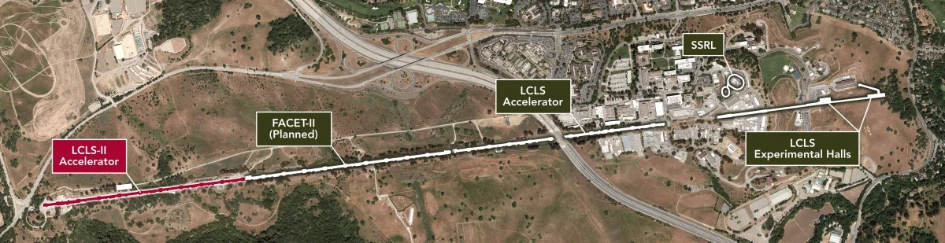
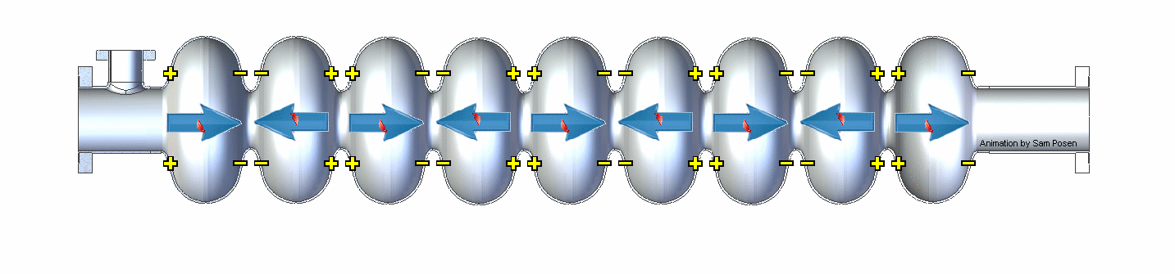
RF Cavity Acceleration and SLAC
0.2 m
Particles are accelerated using electromagnetic waves in cavities in SLAC’s Linear accelerator

Slide 3
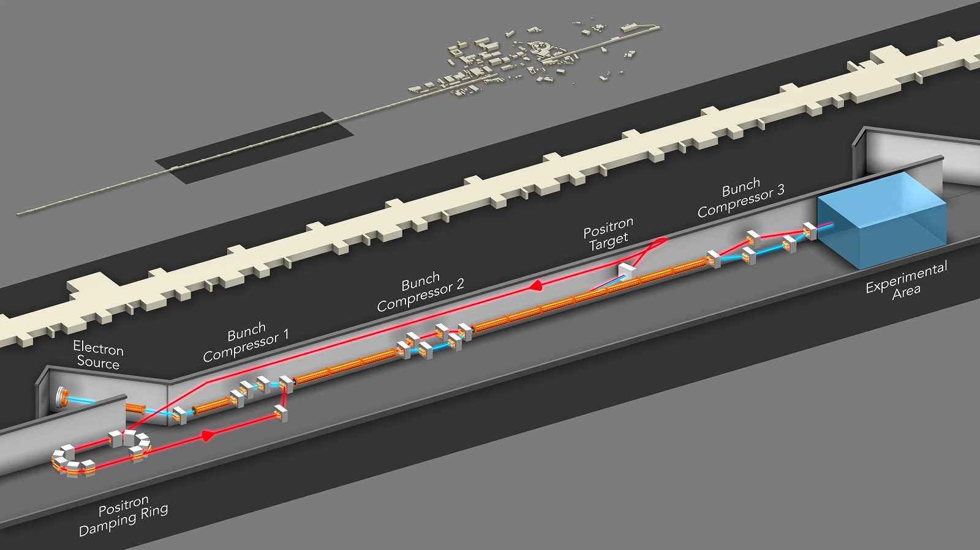
FACET - II

Slide 4
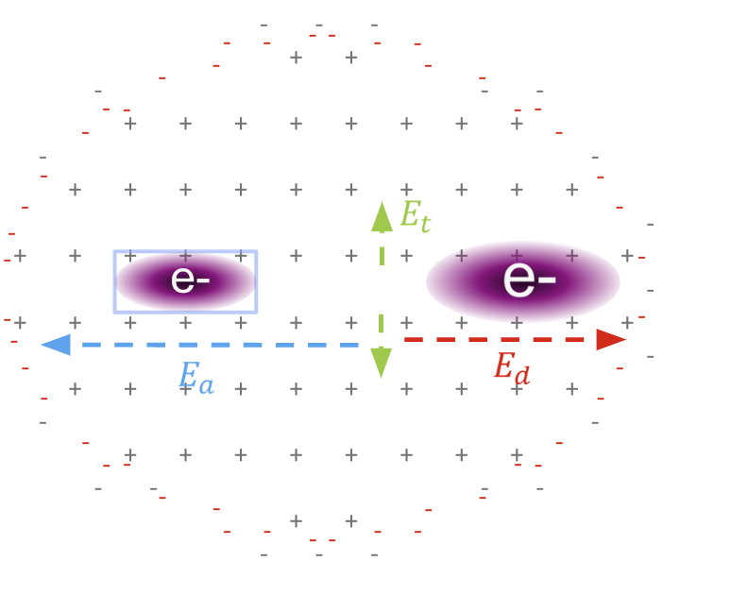
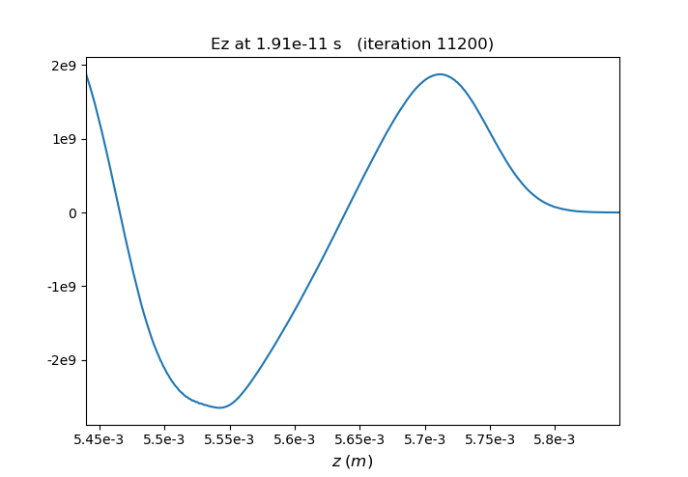
Plasma Wakefield Acceleration
E_{z} (V/m)
200*10⁻⁶ m
A Drive Bunch creates a Wakefield in the plasma which transfers energy to a witness bunch

Slide 5
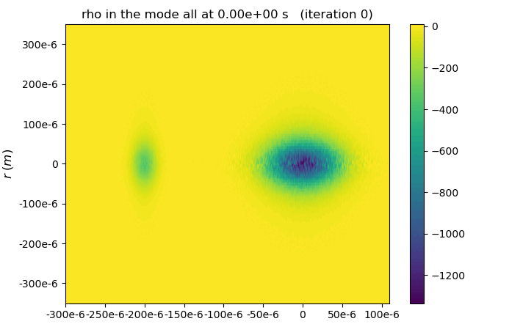
Plasma Wakefield Acceleration (Cont.)
E_{z} (V/m)

Slide 6
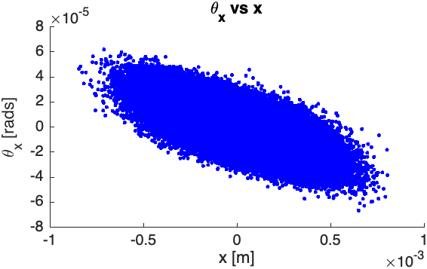
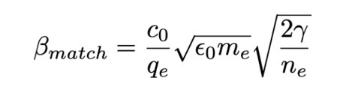
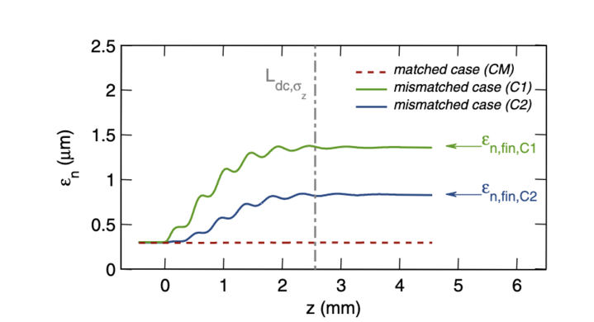
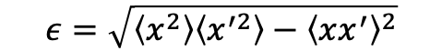
Beam Emittance and Plasma Matching
Beam parameters must be matched to plasma parameters to preserve emittance
$$ε=\sqrt{\left\langle x^{2}\right\rangle \left\langle x^{′2}\right\rangle −{\left\langle xx^{′}\right\rangle }^{2}}$$
M. Stobbe Improvement of Electron Beam Quality in PWFA
T. Mehrling et al., Phys. Rev. ST 15, 111303 (2012)

Slide 7
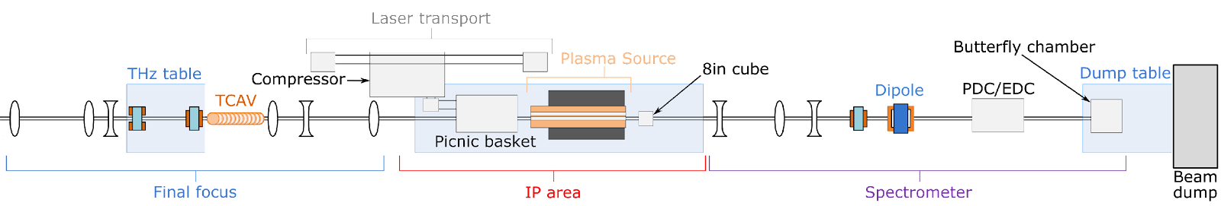
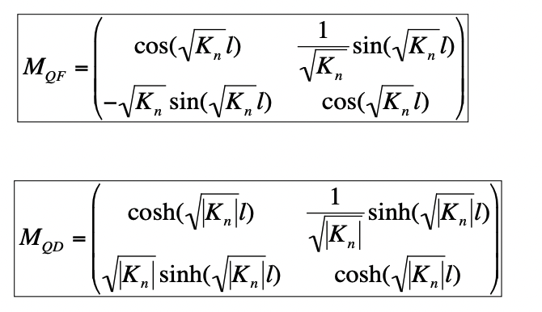
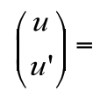
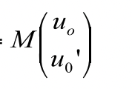
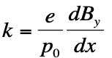
Final Focusing
M. Stobbe Improvement of Electron Beam Quality in PWFA

Slide 8
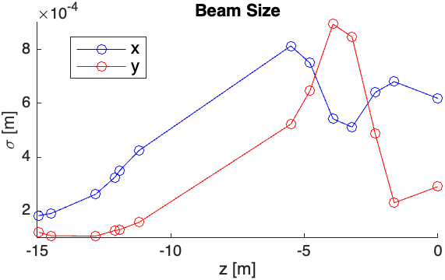
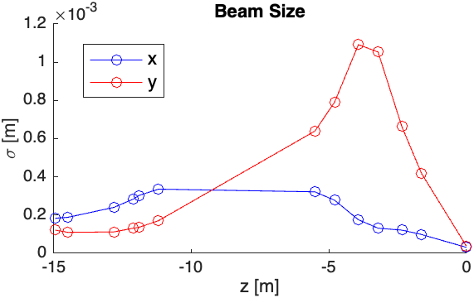
Final Focusing (Cont.)
Quadrupole Magnet Strengths must be chosen carefully to get a beam that is focused and symmetric
M. Stobbe Improvement of Electron Beam Quality in PWFA

Slide 9
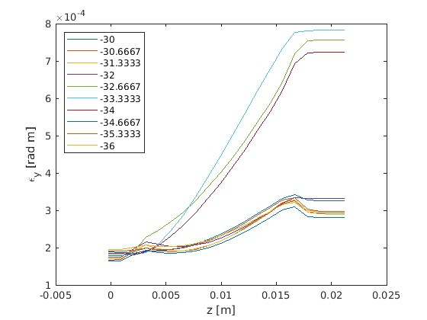
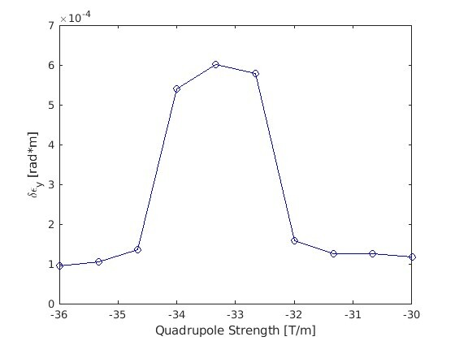
Quadrupole Scans
Which quadrupole strengths best reduce emittance gains?

Slide 10
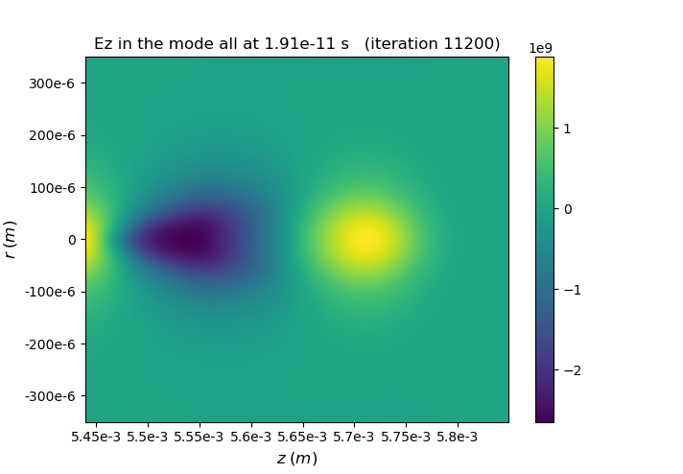
Summary and Conclusion
PWFA uses strong electric fields in plasma to accelerate charged particles
Fields have been generated several orders of magnitude greater than in RF accelerators
Emittance can be conserved by matching beam parameters to plasma
M. Stobbe Improvement of Electron Beam Quality in PWFA

Slide 11
Acknowledgements
Alexander Knetsch
Robert Holtzapple
SLAC and FACET-II
William and Linda Frost Fund
NSF

Slide 12
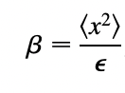
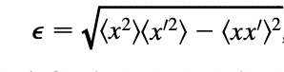
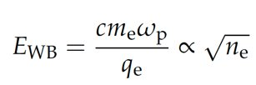
Improvement of Beam Quality in Plasma Wakefield Acceleration
Mason Stobbe
What is Plasma Wakefield Acceleration (PWFA)?
Beam Matching to Plasma
PWFA uses strong electric fields created in plasma to accelerate charged particles over short distances
Beam size and momentum matched to beam energy and plasma density
Quadrupole Scanning
~ 10 GV/M!
Scales with Plasma Density
Strength of focusing Quadrupole Magnets adjusted to manipulate beam parameters and match into plasma

